Slide 1

Big Data Storage and Processing MSc in Data Analytics CCT College Dublin
Apache Hive
Week 10
Lecturer: Dr. Muhammad Iqbal*
Email: miqbal@cct.ie
©CCT College Dublin 2022

Slide 2

Agenda
Introduction to HIVE
Data Hierarchy and HiveQL
Primitive and Complex Data Types
HiveQL Limitations
Hive Metastore and Compiler
Hive Warehouse and Schema
Partitioning and Bucketing
Inserting Data During Table Creation
Relational Operators

Slide 3
Introduction to HIVE
Developed by two Engineers at Facebook and a top-level Apache project because they would need to write quite complex MapReduce jobs.
This technology was developed for already skilled staff using SQL to support their ability for further working on the Hadoop framework.
Facebook manages the Hive-Hadoop cluster, which has more than 3PB of data in storage and loads about 16 TB of data each day. Multiple companies such as IBM, Amazon, Yahoo, Netflix are using hive and developing it continually.
Immediately makes data on a cluster available to non-Java programmers via SQL like queries.
Built on HiveQL (HQL), which is similar to a SQL-like query language.
Enables easy data summarization, ad-hoc reporting and querying, and analysis of large volumes of data.

Slide 4
Introduction to HIVE
Hadoop was first released by Apache in 2011 as Version 1.0.0, which only contained HDFS and MapReduce.
Hadoop was designed as both a computing (MapReduce) and storage (HDFS) platform from the very beginning.
With the increasing need for big data analysis, Hadoop attracts lots of other software to resolve big data questions and merges into a Hadoop-centric big data ecosystem.
In addition, Hive over Spark/Tez along with Live Long And Process (LLAP) offers users the ability to run a query in long-lived processes on different computing frameworks, rather than MapReduce, with in-memory data caching.
Hive was created primarily to work with enormous data sets kept in distributed file systems like HDFS used by Hadoop. The scale and volume of big data, on the other hand, are often too much for SQL databases to handle.

Slide 5
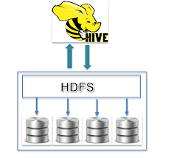
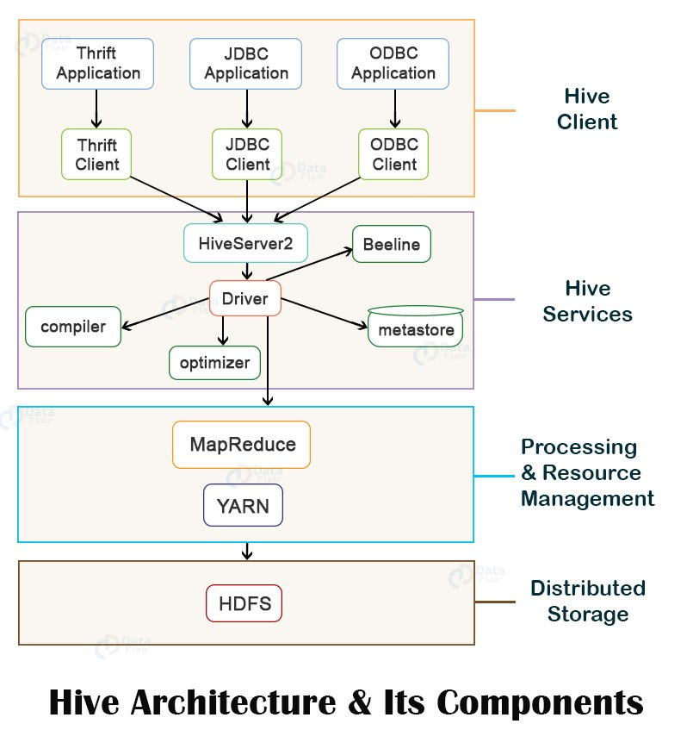
What Hive is Not
Hive, like Hadoop, is designed for batch processing of large datasets
Interprets HiveQL and generates MapReduce jobs that run on the cluster.
Not an OLTP or real-time system
Latency and throughput are both high compared to a traditional RDBMS
Even when dealing with relatively small data ( < 100 MB )

Slide 6
Data Hierarchy
Hive is organised hierarchically into
Databases: namespaces that separate tables and other objects
Tables: homogeneous units of data with the same schema
Analogous to tables in an RDBMS
Partitions: determine how the data is stored
Allow efficient access to subsets of the data
Buckets/ Clusters
For sub-sampling within a partition
Join optimization

Slide 7
Hive Query Language (HiveQL)
HiveQL / HQL provides the basic SQL-like operations
Select columns using SELECT
Filter rows using WHERE
JOIN between tables
Evaluate aggregates using GROUP BY
Store query results into another table
Download results to a local directory (i.e., export from HDFS)
Manage tables and queries with CREATE, DROP, and ALTER

Slide 8
Primitive and Complex Data Types
Type | Comments
Tinyint, smallint, int, bigint | 1, 2, 4 and 8-byte integers
Boolean | TRUE/FALSE
Float, double | Single and double precision real numbers
String | Character string
Timestamp | Unix-epoch offset or datetime string
DECIMAL | Arbitrary-precision decimal
BINARY | Opaque; ignore these bytes
Complex Data Types
Type | Comments
Struct | A collection of elements If S is of type STRUCT {a INT, b INT}: S.a returns element a
MAP | Key-value tuple If M is a map from 'group' to GID: M['group'] returns value of GID
Array | Indexed list If A is an array of elements ['a','b','c']: A[0] returns 'a'
Primitive Data Types

Slide 9
HiveQL Limitations
HQL only supports equi-joins, outer joins, left semi-joins
Because it is only a shell for MapReduce, complex queries can be hard to optimise
Missing large parts of full SQL specification:
HAVING clause in SELECT
Correlated sub-queries
Sub-queries outside FROM clauses
Updatable or materialized views
Stored procedures

Slide 10
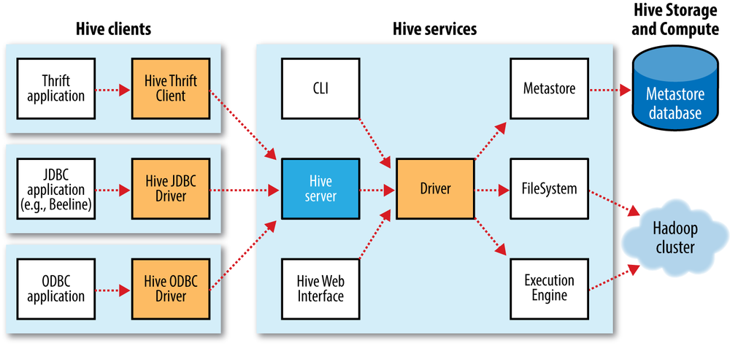
Hive Architecture
A metastore in Apache Hive is a central repository that contains metadata about the data kept in Hive tables. It is frequently referred to as the Hive Metastore. The metadata has details required for managing and querying the data, including as table schemas, column names, data types, file locations, and others.

Slide 11
Hive Architecture
Thrift Client
HiveServer is an optional service that allows a remote client to submit requests to Hive, using a variety of programming languages, and retrieve results. HiveServer is built on Apache ThriftTM (http://thrift.apache.org/), therefore it is called the Thrift server although this can lead to confusion because a newer service named HiveServer2 is also built on Thrift.
JDBC driver
Hive provides a JDBC driver, defined in the class org.apache.hadoop.hive.jdbc.HiveDriver. When configured with a JDBC URI of the form jdbc:hive2://host:port/dbname, a Java application will connect to a Hive server running in a separate process at the given host and port. In this mode, Hive runs in the same JVM as the application invoking it.
The Beeline CLI uses the JDBC driver to communicate with Hive.
ODBC driver
An ODBC driver allows applications that support the ODBC protocol (such as business intelligence software) to connect to Hive. The Apache Hive distribution does not ship with an ODBC driver, but several vendors make one freely available.
Notes:
https://cwiki.apache.org/confluence/display/hive/hiveserver

Slide 12
Hive Metastore
Stores Hive metadata
Default metastore database uses Apache Derby due to simplicity, no external dependencies and quick start.
Hive provided the facility to use MySQL, PostgreSQL, Oracle, and Microsoft SQL Server
Various configurations:
Embedded (in-process metastore, in-process database)
Mainly for unit tests
Local (in-process metastore, out-of-process database)
Each Hive client connects to the metastore directly
Remote (out-of-process metastore, out-of-process database)
Each Hive client connects to a metastore server, which connects to the metadata database itself

Slide 13
Hive Compiler
The following task is performed during the compilation phase of a query.
Parser: This stage transforms the query string into a parse tree.
Semantic Analyser: Column names, type checking, implicit conversion type, and expression verification are all carried out in this complier stage. To determine whether a partition is required in the partition table scenario, the expression details are gathered.
Logical Plan Generator: The query is converted into a logical plan which includes the relational algebra operators such as "join", "filter, and so on. In this plan, the optimizer transforms the plan to tune the performance.
Query Plan Generator: The logical plan is converted into the Map-Reduce task that is further submitted on Hadoop HDFS.

Slide 14
Hive Warehouse and Schemas
Hive tables are stored in the Hive “warehouse”
Default HDFS location: /user/hive/warehouse
Tables are stored as sub-directories in the warehouse directory
Partitions are subdirectories of tables
External tables are supported in Hive
The actual data is stored in flat files
Hive is schema-on-read
Schema is only enforced when the data is read (at query time)
Allows greater flexibility: same data can be read using multiple schemas
Contrast with an RDBMS, which is schema-on-write
Schema is enforced when the data is loaded
Speeds up queries at the expense of load times

Slide 15
Create Table Syntax
CREATE TABLE table_name
(col1 data_type,
col2 data_type,
col3 data_type,
col4 datatype )
ROW FORMAT DELIMITED
FIELDS TERMINATED BY ','
STORED AS format_type;
CREATE TABLE employees(
(name STRING,
salary FLOAT,
subordinates ARRAY<STRING>,
deductions MAP<STRING, FLOAT>,
address STRUCT<street:STRING,
city:STRING,
state:STRING,
zip:INT>)
ROW FORMAT DELIMITED
FIELDS TERMINATED BY '\t'
STORED AS TEXTFILE;
CREATE TABLE page_view
(viewTime INT,
userid BIGINT,
page_url STRING,
referrer_url STRING,
ip STRING COMMENT 'IP Address of the User' )
ROW FORMAT DELIMITED
FIELDS TERMINATED BY '\t'
STORED AS TEXTFILE;

Slide 16
Partitioning and Bucketing
Can make some queries faster
Divide data based on partition column
Use PARTITION BY clause when creating table
Use PARTITION clause when loading data
SHOW PARTITIONS will show a table’s partitions
Can speed up queries that involve sampling the data
Sampling works without bucketing, but Hive has to scan the entire dataset
Use CLUSTERED BY when creating table
For sorted buckets, add SORTED BY
To query a sample of your data, use TABLESAMPLE
https://www.cloudduggu.com/hive/partitioning/

Slide 17
Browsing Tables And Partitions
Command | Comments
SHOW TABLES; | Show all the tables in the database
SHOW TABLES 'page.*'; | Show tables matching the specification ( uses regex syntax )
SHOW PARTITIONS page_view; | Show the partitions of the page_view table
DESCRIBE page_view; | List columns of the table
DESCRIBE EXTENDED page_view; | More information on columns (useful only for debugging)
DESCRIBE page_view PARTITION (ds='2008-10-31'); | List information about a partition

Slide 18
Loading Data
Use LOAD DATA to load data from a file or directory
Will read from HDFS unless LOCAL keyword is specified
Will append data unless OVERWRITE specified
PARTITION required if destination table is partitioned
LOAD DATA LOCAL INPATH '/tmp/pv_2008-06-8_us.txt’
OVERWRITE INTO TABLE page_view
PARTITION (date = '2008-06-08', country = 'US')

Slide 19
Inserting Data
Use INSERT to load data from a Hive query
Will append data unless OVERWRITE specified
PARTITION required if destination table is partitioned
FROM page_view_stg pvs
INSERT OVERWRITE TABLE page_view
PARTITION (dt = '2008-06-08', country = 'US’)
SELECT pvs.viewTime, pvs.userid, pvs.page_url, pvs.referrer_url
WHERE pvs.country = 'US';

Slide 20
Inserting Data During Table Creation
Use AS SELECT in the CREATE TABLE statement to populate a table as it is created
CREATE TABLE page_view AS
SELECT pvs.viewTime, pvs.userid, pvs.page_url,
pvs.referrer_url
FROM page_view_stg pvs
WHERE pvs.country = 'US';

Slide 21
Sample Select Clauses
Select from a single table
SELECT *
FROM sales
WHERE amount > 10 AND
region = "US";
Select from a partitioned table
SELECT page_views.*
FROM page_views
WHERE page_views.date >= '2008-03-01' AND
page_views.date <= '2008-03-31';

Slide 22
Relational Operators
ALL and DISTINCT
Specify whether duplicate rows should be returned
ALL is the default (all matching rows are returned)
DISTINCT removes duplicate rows from the result set
WHERE
Filters by expression
Does not support IN, EXISTS or sub-queries in the WHERE clause
LIMIT
Indicates the number of rows to be returned

Slide 23
Relational Operators
GROUP BY
Group data by column values
Select statement can only include columns included in the GROUP BY clause
ORDER BY / SORT BY
ORDER BY performs total ordering
Slow, poor performance
SORT BY performs partial ordering
Sorts output from each reducer

Slide 24
Resources/ References
Lecture is prepared based on the slides provided by Hadoop-Based Distributed Computing, Adam Shook, 2016. https://www.csee.umbc.edu/~shadam1/491s16/lectures/07-Hive.pptx
http://hive.apache.org
https://www.cloudduggu.com/hive
Some images are used from Google search repository (https://www.google.ie/search) to enhance the level of learning.
Copyright Notice The following material has been communicated to you by or on behalf of CCT College Dublin in accordance with the Copyright and Related Rights Act 2000 (the Act). The material may be subject to copyright under the Act and any further reproduction, communication or distribution of this material must be in accordance with the Act. Do not remove this notice

